Slide 1
SALVE
Attributes & Templates
Zak Moore
09-Oct-21
Status - draft

Slide 2
Contents
Minimal Bureaucracy
Lean Scenes > Experiments, Hypotheses, OKRs, PRB, Steering committee
Business Cases
  A4# - SMART
  A4# - INVEST
  OKR + ROI 2 ways
  Opportunity Assessment
Benefits: words and numbers
  Value Chain Blueprint
  G+ strategic framework
Risk Matrices: RAID, SVPG, ROAM
Workshop templates and design

Slide 3
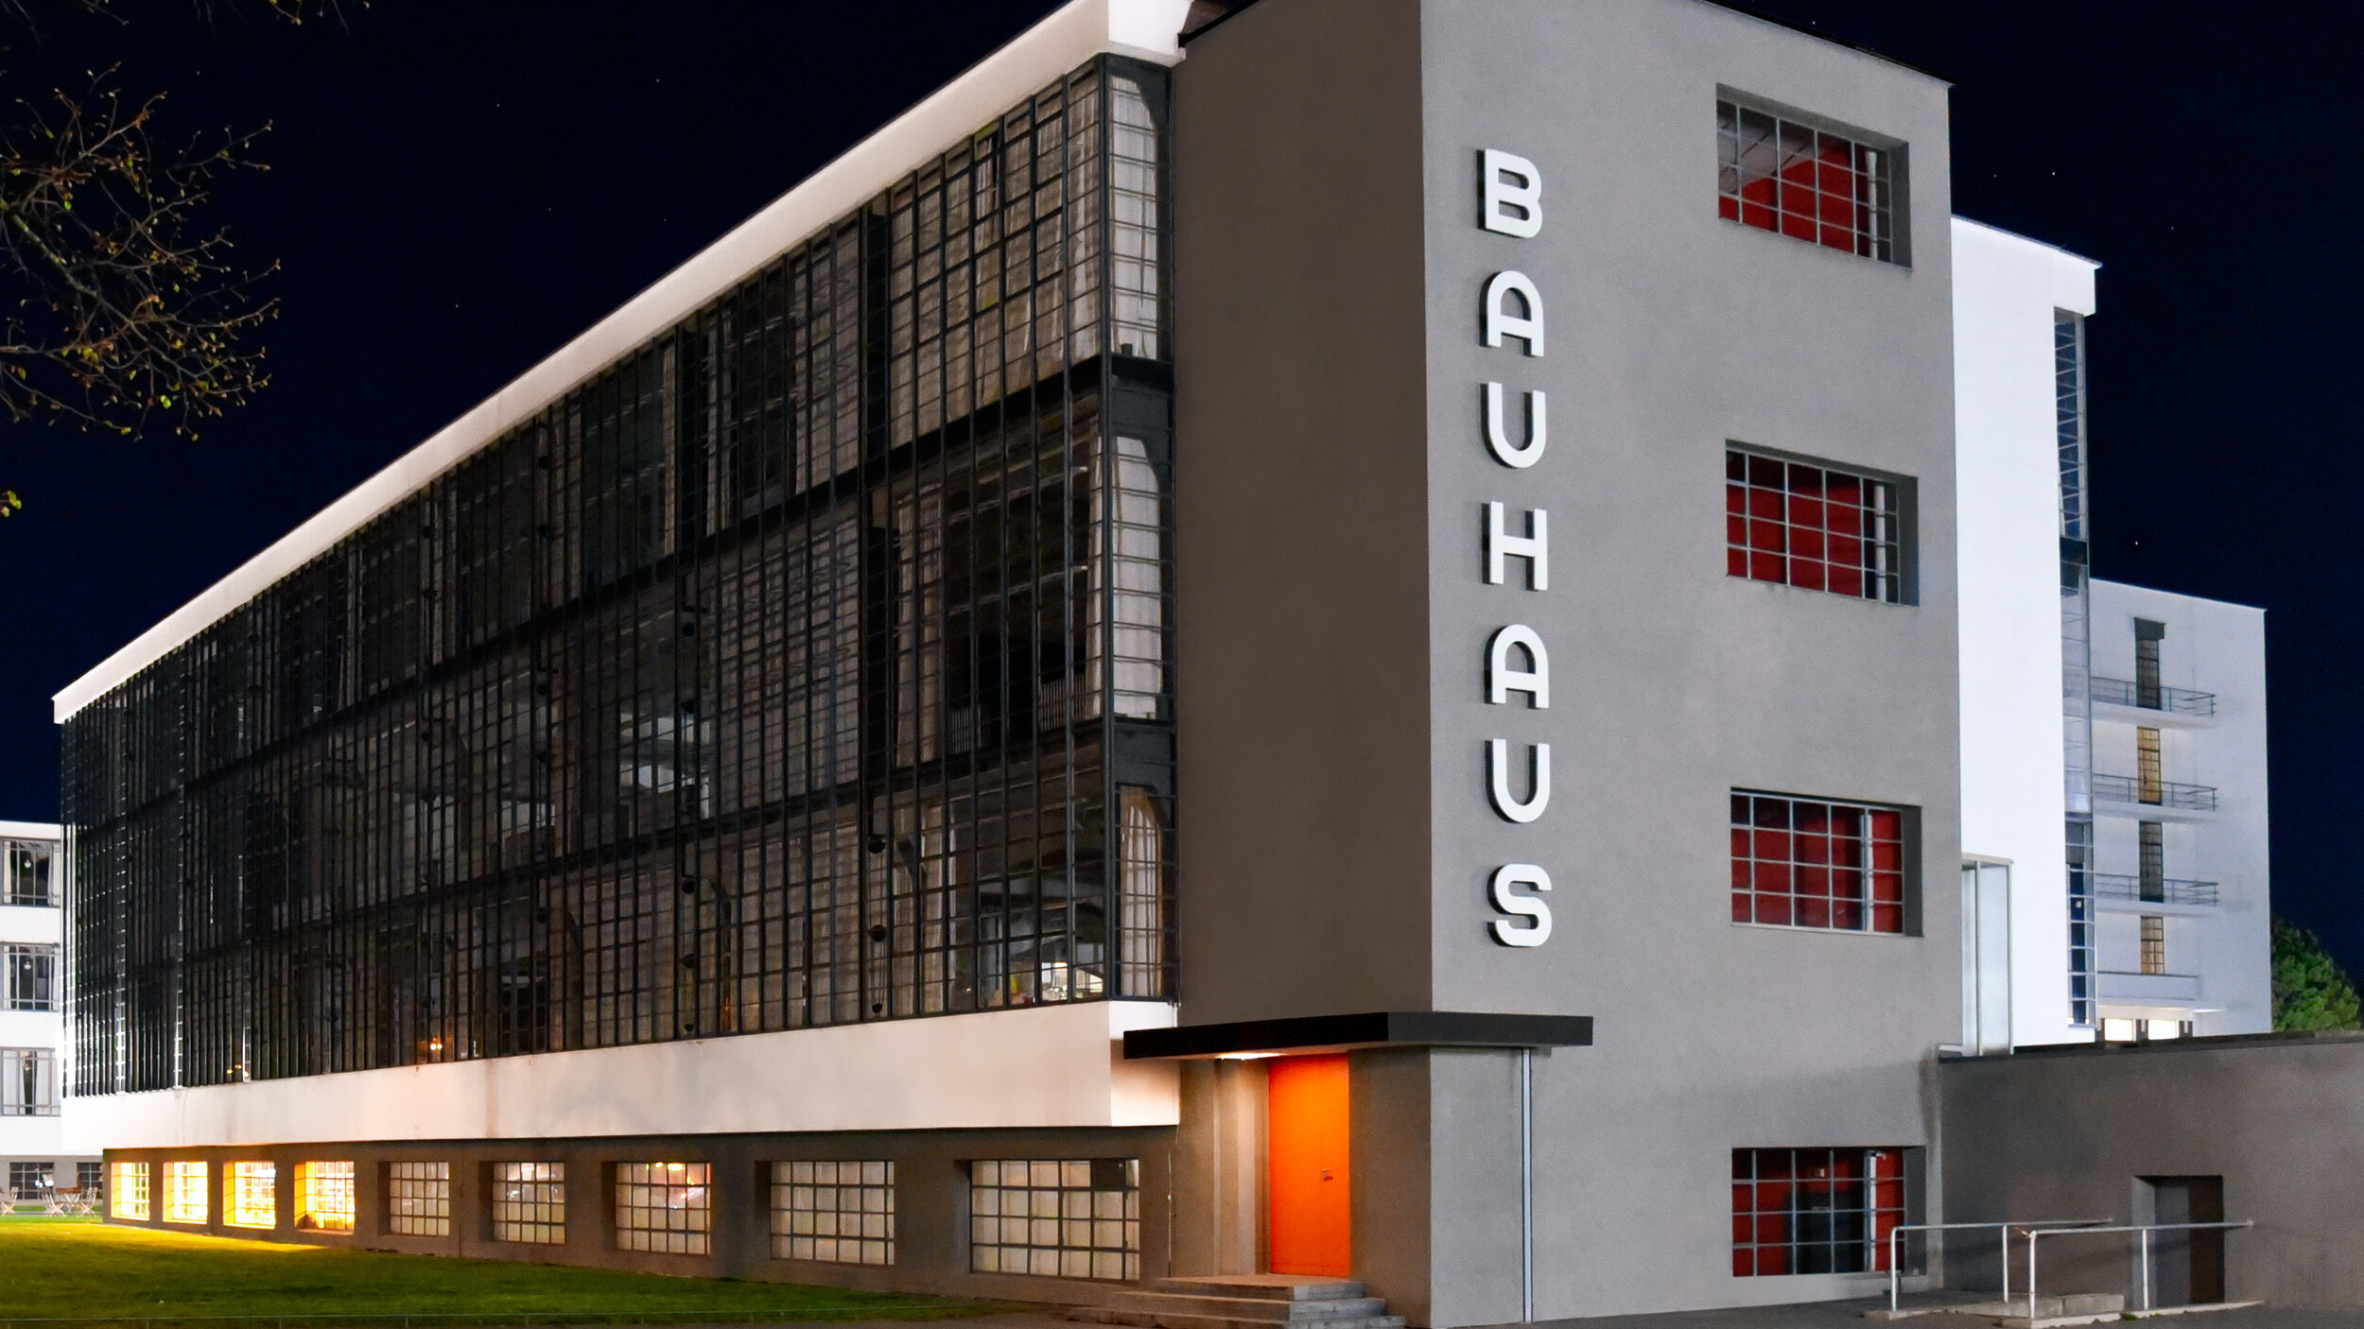
Firm follows form follows function
Apply Bauhaus mentality to bureaucracy
Minimal. Creative. Collaborative
  Workshop before paperwork
Efficient. Risk reduction. Learning
  Easy to understand at all levels
Functional and timely
  Lightweight governance

Slide 4
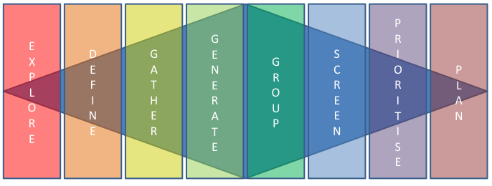
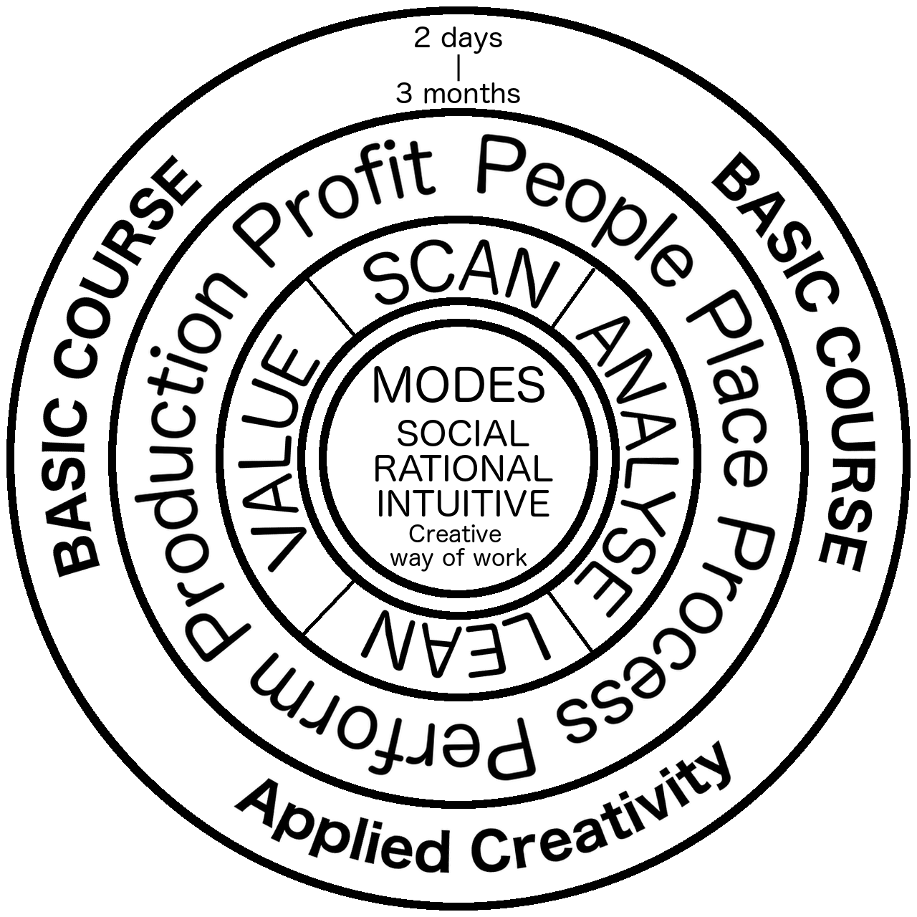

Workshop
Designs
Agenda
Subject
Place
Date Time
Attendees
Organiser
Facilitator
Creative Template
Essential reflection
personal and/or corporate
Output Actions
What, Who, When
1
2
3
4
5
Reflected Actions
What, Who, When
1
2
3
4
5

Slide 5
Lean Scene Template
Set the Scene
Present a very succinct elevator pitch.
TEAM
It is likely that an initiative will be piloted by one team. Show their benefits.
OPERATIONS
State the benefits in: learning, implementation and commercialisation
STRATEGY
State the benefits in: automation, national differences using economies of scope and scale

Slide 6
A4# Process Improvement Template
Background
Actions
Current Condition
Scan
Lean
Confirmation: What is your definition of done?
Goals
S
M
A
R
T
Follow up: contingency if things don’t work out?
Analyse
Operational ROI
Value
Root Cause Analysis
Learning
Implementation
Commercial
Strategic ROI
Automation
Globalisation
Scale Economies
Scope Economies

Slide 7
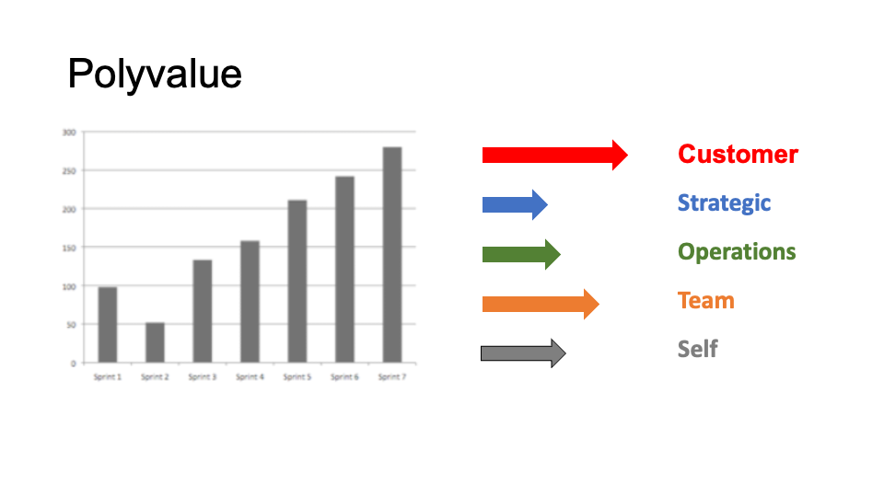
Idea Development - workflow
A4#
Idea
Lean Scene
Scan
Lean
A4#
Analyse
Value
Opportunity to develop
Using modes
Intuitive
Rational
Social
Focus on the rational
To convince players
Back it up with thinking
Show the benefits to:
Teams
Operations
Strategy
Customers
Run the initiative
Do it as a pilot
Measure key metrics
Share successes
Aggregate success
Transform

Slide 8
Lean Scene & A4# Mapping
Experiment
Set the aim and the goals from three perspectives
Team, operations, strategy.
Lean scene
Hypothesis
Aims and goals as well as
Baconian and Hegelian dialectics
Convert to A4# case
if there is significant
money, time, risk
involved
Objective
Key Result
Provide cost, time and SMART goals from
The ROI words first and numbers second
A4#
Product
Review
Board
Specify the operational returns on:
Learning, implementation, commercialisation
Steering
Committee
Specify the strategic returns on:
Automation, Offshoring, Economies of scope and scale

Slide 9
Templates and Forms
Opportunity
Business Cases
Risks
Benefits
Progress
Assessments
Lean Scenes
OKRs
A4#
SteerCo (tbd)
PRB (tbd)
RAID
SVPG
ROAM
VCB
G+
Scope & Scale
RAG
Service Eval
Check lists
What about levels – strategy, operations, teams???

Slide 10
Opportunity (Hypothesis) Assessment
Background
Key Result
Problem
Primary Objective
Key Performance Indicators
S
M
A
R
T
Follow up: contingency if things don’t work out
Root Cause Analysis

Slide 11
Hypothesis Testing
Personal
  Tribe – local views
  Cave - personal experience
  Market – User Research
  Theatre – Stan, Disney, Brecht
Groups
  Hegelian
Red Team Bureaucracy
  Steer Co
  PRB

Slide 12
OKR - business
Background
Key Result
Problem
KPI
Objective
Countermeasures & Contingency
S
M
A
R
T
Operational ROI
Root Cause Analysis
Learning
Implementation
Commercial
Strategic ROI
Automation
Global
Scale Economies
Scope Economies

Slide 13
OKR - feature
Background
Key Result
Problem
KPI
Objective
Operational ROI
I
N
V
E
S
T
Learning
Implementation
Commercial
Strategic ROI
Automation
Global
Scale Economies
Scope Economies
Root Cause Analysis
Countermeasures & Contingency

Slide 14
Risk Matrix – V2FU
value risk
(whether customers will buy it or users will choose to use it)
usability risk
(whether users can figure out how to use it)
feasibility risk
(whether our engineers can build what we need
with the time, skills and technology we have)
business viability risk
(whether this solution also works for the
various aspects of our business)

Slide 15
Risk Matrix - RAID
Risk
Issue
Actions
Decisions

Slide 16
Risk Matrix - ROAM
Risk
Owned
Action
Mitigation

Slide 17
OKR Variations
Business
Technical

Slide 18

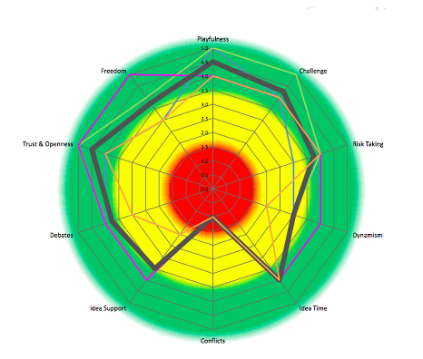
Use Case Success Story
Loss
Insight
Result
3 small wins
Conflict
4 Ds
Resistance & Rebuke
Problem
Checklists and Appreciative Inquiry
Define the problem that the client has
Define the loss in words and numbers
Journey
The 4 Ds are:
Denial
Distraction
Doubt
Delay
Intervene using Climate. Design a solution
Transformation
There is always resistance followed by rebuke - Use climate to call in Top Cover
Present a lean scene. Ask for others
Run the intervention – allow time to embed (6 – 8 weeks)

Slide 19
Value Stream Blueprint
Discovery and Learning | Implementation | Commercialisation
Internal Renewal Research & Development Work force development Organisational Capital Process | Intellectual Property Patents, trademarks & copyrights Know-how and know-who Licensing Agreements Coded know-how | Customers Brand Values Customer churn & value Online sales Consultancy
Acquired capabilities Technology purchase/lease Spill over utilisation Capital Expenditure | Technological Feasibility Pilots and MVPs First Mover Best Mover | Performance Revenue, earnings & market share Innovation revenues Collaborate with initial customers to improve
Networking R&D alliances & Joint Ventures Supplier & customer integration Communities of practice | Internet (of things?) Traffic analysis Online purchases Internet alliances Always on staff | Growth Prospects Product pipeline dates Expected efficiency savings Planned initiatives Break-even and cash-burn rates
Cost/Invest |  | $€¥£
Income |  | $€¥£
ROI |  | $€¥£/T

Slide 20
Green+ Organising Framework | G+ Organizing Framework
 | Green Initiatives | Automation | Scope Economies | Scale Economies
Achieving efficiency in current operations | Government Credits? Re-sell to others? | Develop and apply automation and that takes time to develop. | Trial by pilot Incorporate emergence to realize strategy | Sharing of investments and costs across products, markets and businesses
Managing risks | Corporate Social Responsibility to improve Net Promoter Score | Hedging options against unproven innovation initiatives. | Keep marketing and tech separate but complimentary | Portfolio diversification of risks and creation of options and side-bets
Innovation, learning and adaptation | Listen to the concerns of staff. Invite & enable action from all staff | Idea time and support will require climate changes. | Team level trials Review, critique at team, operations and strategic levels | Shared learning across organisational components in different products, markets or businesses
Invest(£k) |  |  |  | $€¥£
Cash position |  |  |  | $€¥£
ROI |  |  |  | $€¥£/T

Slide 21
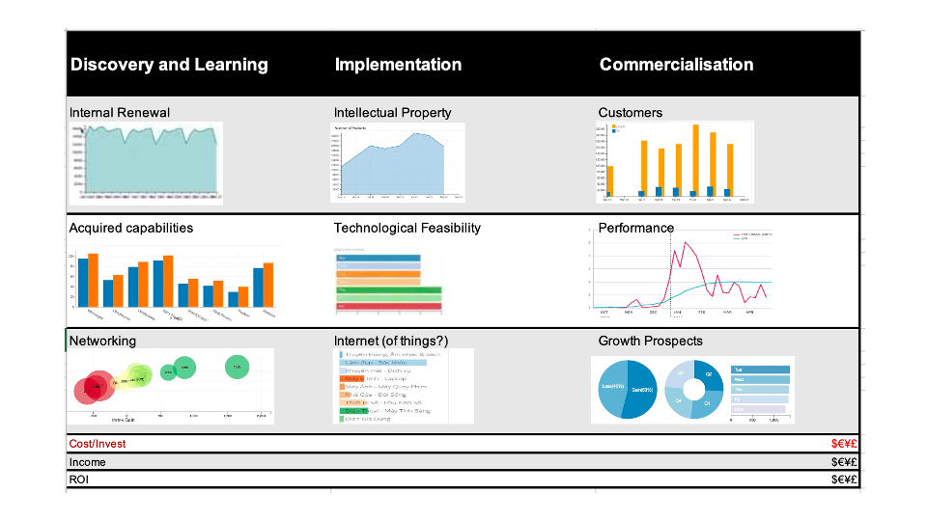
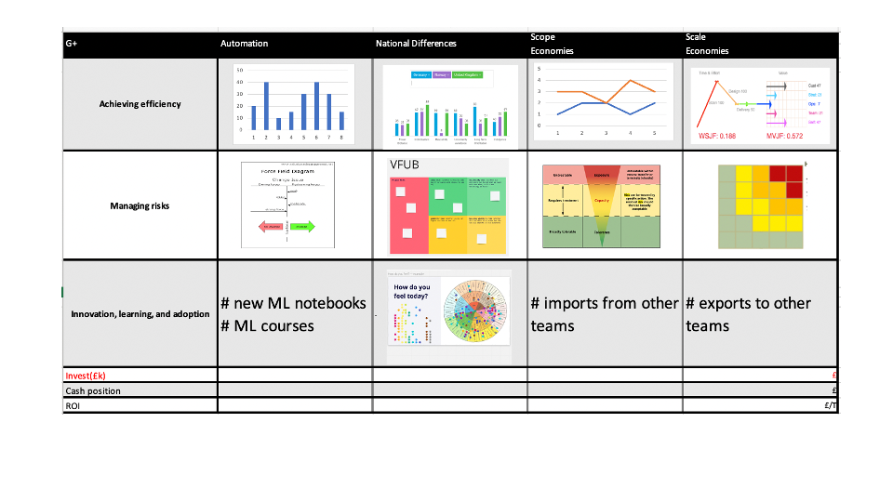
DASHBOARD IDEAS

Slide 22
OKR - business
Background
Problem
Objective
Key Result
S
M
A
R
T
KPI
Cascading Key Results
Risk Progress
Objective Key Result Owner C U F B

Slide 23
Discovery
Opportunity Assessment
Techniques and tools (neu bau)
Problem Statement
Desk Research
User Interviews
Prototype
User Testing
Flesh out use case
Solo Collaboration
Divergent/Convergent 3 ways
Lean scenes
Value Blueprint & G+

Slide 24
Governance
Planning
  Value Chain Blueprint
  G+
Monitor and Reporting - tbd
  QfD
  RAG(V)
Anything else?

Slide 25
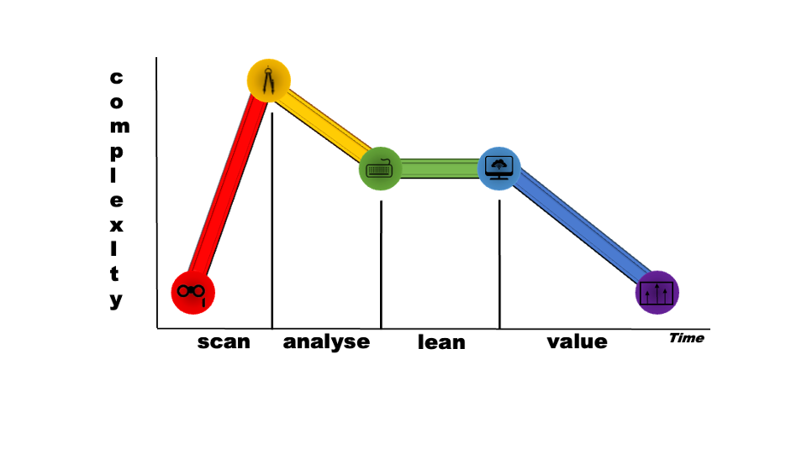
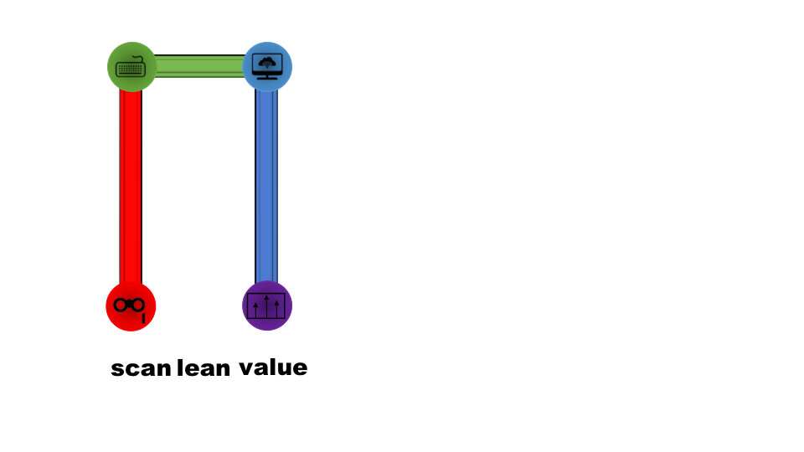
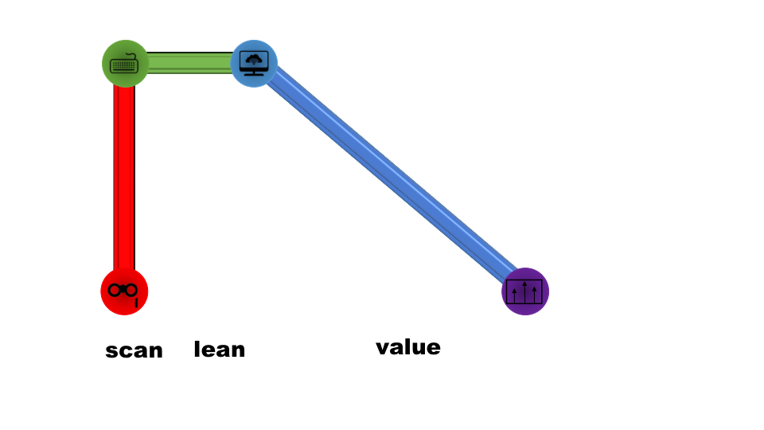
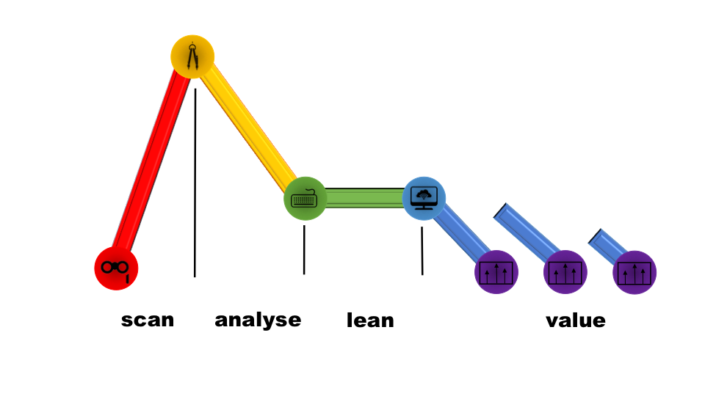
Sizing and estimation

